Slide 1

DEPARTMENT OF BIOMEDICAL ENGINEERING
Zeroth Review
ADAPTIVE IoT-BASED RESPIRATORY MONITORING AND EARLY WARNING SYSTEM
GUIDED BY,
Mrs. S. KEERTHANA, M.E
ASSITANT PROFESSOR
DEPARTMENT OF BIOMEDICAL ENGINEERING
V.S.B ENGINEERING COLLEGE, KARUR.
PRESENTED BY,
DHIVYA RANJANI(922524121004)
RAMYA M(922524121021)

Slide 2
ABSTRACT
This project presents an IoT-based wearable embedded system for continuous, multi-parameter monitoring of a patient’s respiratory pattern, blood-oxygen saturation (SpO2), heart rate, and body temperature.
A flexible respiration sensor, a MAX30102 optical pulse-oximetry sensor, and a body-temperature sensor are interfaced with a low-power ESP32 microcontroller for real-time signal acquisition and processing.
The system cross-checks respiratory rate against SpO2 and heart-rate trends to reliably detect abnormal patterns such as apnea, bradypnea, and tachypnea, while reducing false alarms.
On detecting an abnormality, the wearable instantly triggers a local vibration/buzzer alert and pushes a real-time notification to a cloud dashboard and mobile app for the caregiver.
The device is compact, low-power, rechargeable, and non-invasive, designed for continuous day-long wear in home care, elderly monitoring, and post-operative recovery settings.

Slide 3
INTRODUCTION
Respiratory disorders such as sleep apnea, COPD, and asthma often progress unnoticed without continuous monitoring, especially outside hospital settings.
The convergence of wearable sensors and the Internet of Things (IoT) now enables continuous, unobtrusive tracking of physiological signals beyond clinical environments.
Respiratory abnormalities are frequently accompanied by changes in blood-oxygen saturation and heart rate, so combining multiple parameters improves the reliability of early-warning detection.
The proposed wearable streams respiration, SpO2, heart-rate, and temperature data to a cloud dashboard and mobile app, allowing caregivers to monitor patients remotely in real time.

Slide 4
OBJECTIVES
To design a compact wearable IoT device that integrates respiratory-rate, SpO2, heart-rate, and body-temperature sensing in a single low-power unit.
To continuously compute the breathing pattern and classify it as normal, bradypnea, tachypnea, or apnea using clinically defined thresholds.
To cross-validate respiratory alerts against SpO2 and heart-rate trends, improving detection reliability and reducing false alarms.
To enable real-time WiFi/BLE connectivity to a cloud dashboard and mobile app that instantly notifies caregivers of abnormal readings.
To build a rechargeable, ergonomic, and low-power wearable suitable for continuous, all-day use in home and clinical settings.

Slide 5
LITERATURE SURVEY
S.NO | TITLE | AUTHOR | PUBLICATION & YEAR | DESCRIPTION
1 | IoT Health Monitoring Device of Oxygen Saturation (SpO2) and Heart Rate Level | O. Y. Tham, M. A. Markom, A. H. A. Bakar, E. S. M. M. Tan, A. M. Markom | ICITAMEE, IEEE, 2020 | ESP8266-based wearable using a MAX30100 sensor to continuously measure heart rate and SpO2 and push readings to the cloud.
2 | Design and Implementation of IoT Enabled Low Cost SPO2 and Heart Rate Monitoring System | Khushi Singh, Pradheep Thiyagarajan, Sasikumar P. | IEEE DELCON, 2022 | Low-cost pulse-oximetry wearable transmitting heart-rate and SpO2 data over IoT for continuous tracking.
3 | Design a Medical Device to Monitor the Human Body (SpO2, Heart Rate, Body Temperature) | M. I. Kadhim, R. A. Fayadh, J. F. Mahdi | IEEE ICNAS, 2022 | Multi-parameter device combining SpO2, heart-rate, and body-temperature sensing for simultaneous monitoring.
4 | E-Health Tracker: An IoT-Cloud Based Health Monitoring System | D. K. S. Nadiger, J. Dhanush, R. Vikas, S. K. B V, A. R. Naik, C. G. M | IEEE ICSSIT, 2022 | Cloud-connected multi-sensor health tracker that logs vitals continuously and raises alerts on abnormal readings.
5 | State of the Art Review of Wearable Devices for Respiratory Monitoring | Z. Jia, H. Huth, W. Q. Teoh, S. Xu, B. Wood, Z. T. H. Tse | IEEE Access, vol. 13, 2025 | Reviews wearable respiratory-monitoring technologies, highlighting the shift toward multi-parameter, sensor-fused platforms.

Slide 6
EXISTING SYSTEM
Consumer smartwatches casually estimate heart rate and SpO2 but are not clinically validated and lack dedicated respiratory-rate tracking or early-warning alerts.
Most existing embedded monitors rely on GSM/SMS for alerts, which adds recurring SIM cost and delay compared to instant IoT/cloud notifications.
Hospital bedside monitors track respiration, SpO2, heart rate, and temperature accurately but are bulky, wired, and confined to ICU or ward settings.
.Dedicated respiratory monitors, such as piezoelectric-belt devices, track only breathing rate and cannot cross-verify readings against other vital signs.

Slide 7
EXISTING SYSTEM – BLOCK DIAGRAM
Power Supply Unit
Respiration Sensor
(Piezoelectric)
Arduino Microcontroller
16x2 LCD Display
Buzzer (Local Alarm)
GSM Module
SMS Alert to Caregiver
.

Slide 8
DISADVANTAGES OF EXISTING SYSTEM
Single-Parameter Focus – Most devices track only respiration or only SpO2/heart rate, without fusing multiple vitals for reliable early warning.
Limited Portability – Wired, multi-sensor hospital systems restrict patient movement and are unsuitable for day-to-day wearable use.
GSM Dependency & Cost – SMS-based alerts require an active SIM connection, adding recurring cost and network-dependent delay.
No Cloud Analytics – Data is rarely logged centrally, so caregivers cannot review historical trends or long-term patterns.
Manual Calibration – Existing devices need manual threshold adjustment and lack automatic self-checking across sessions.

Slide 9
PROBLEM STATEMENT
Respiratory abnormalities such as apnea, bradypnea, and tachypnea often progress unnoticed until they become severe, particularly outside hospital settings.
Existing hospital-grade monitors are bulky, wired, and confined to ICU or ward use, making them impractical for continuous home or elderly-care monitoring.
Consumer smartwatches estimate heart rate and SpO2 but are not clinically validated and lack dedicated respiratory-rate tracking or early-warning alerts.
Devices that rely on GSM/SMS-based alerts add recurring SIM cost and delay, instead of instant, low-cost cloud-based notifications.
There is a clear need for an affordable, compact, and low-power wearable that continuously and reliably detects abnormal respiratory patterns and alerts caregivers in real time.

Slide 10
PROPOSED SYSTEM
A wearable unit fuses a flexible respiration sensor, a MAX30102 SpO2/heart-rate sensor, and a body-temperature sensor around a low-power ESP32 microcontroller.
The ESP32 computes real-time respiratory rate and cross-checks it against SpO2 and heart-rate trends to classify normal, bradypnea, tachypnea, or apnea patterns.
WiFi/BLE connectivity streams live data to a cloud dashboard and companion mobile app, maintaining a continuous history for caregivers.
On detecting an abnormal multi-parameter pattern, the device instantly triggers a local vibration/buzzer alert and a push notification to the caregiver’s phone.
A rechargeable Li-Po battery and compact chest-strap/wrist form factor make the device suitable for continuous, all-day wearable monitoring.

Slide 11
PROPOSED SYSTEM – BLOCK DIAGRAM
Piezoelectric
Respiration Sensor
0.96" OLED Display
ESP32
Microcontroller
(WiFi + BLE)
MAX30102
(SpO2 & Heart Rate)
Vibration Motor &
Buzzer (Local Alert)
Body Temperature
Sensor (DS18B20
Push Button
(Silence Alarm)
Li-Po Battery +
TP4056 Charging
WiFi / BLE Link
Cloud Dashboard
Mobile App /
Caregiver Alert

Slide 12
COST ESTIMATION
S.NO | COMPONENT | APPROXIMATE COST (Rs.)
1 | ESP32 Development Board (WiFi + BLE) | Rs. 450
2 | MAX30102 SpO2 & Heart-Rate Sensor | Rs. 350
3 | Flexible Piezoelectric Respiration Sensor | Rs. 400
4 | DS18B20 Body Temperature Sensor | Rs. 150
5 | 0.96" OLED Display | Rs. 200
6 | Vibration Motor & Buzzer | Rs. 80
7 | Li-Po Battery & TP4056 Charging Module | Rs. 350
8 | Wearable Strap, Enclosure & Miscellaneous | Rs. 300
 | TOTAL | Rs. 2,280 (approx.)

Slide 13
ADVANTAGES
Multi-Parameter Fusion – Combining respiration, SpO2, heart rate, and temperature improves early-warning accuracy and reduces false alarms.
Wearable & Lightweight – Compact chest-strap/wrist design allows continuous, unobtrusive all-day monitoring.
Instant Cloud Alerts – Real-time WiFi/BLE notifications reach caregivers faster than GSM/SMS, without recurring SIM cost.
Rechargeable & Low Power – Li-Po battery with low-power sleep modes supports extended wearable use.

Slide 14
APPLICATIONS
Home & Elderly Care – Enables family members to remotely track a person’s breathing and vital signs.
Post-Operative Recovery – Assists hospital staff in continuously monitoring recovering patients for respiratory complications.
Sleep Apnea Screening – Provides a low-cost, wearable tool for identifying irregular breathing during sleep.
Sports & Fitness Monitoring – Tracks breathing and heart-rate patterns during physical activity.

Slide 15
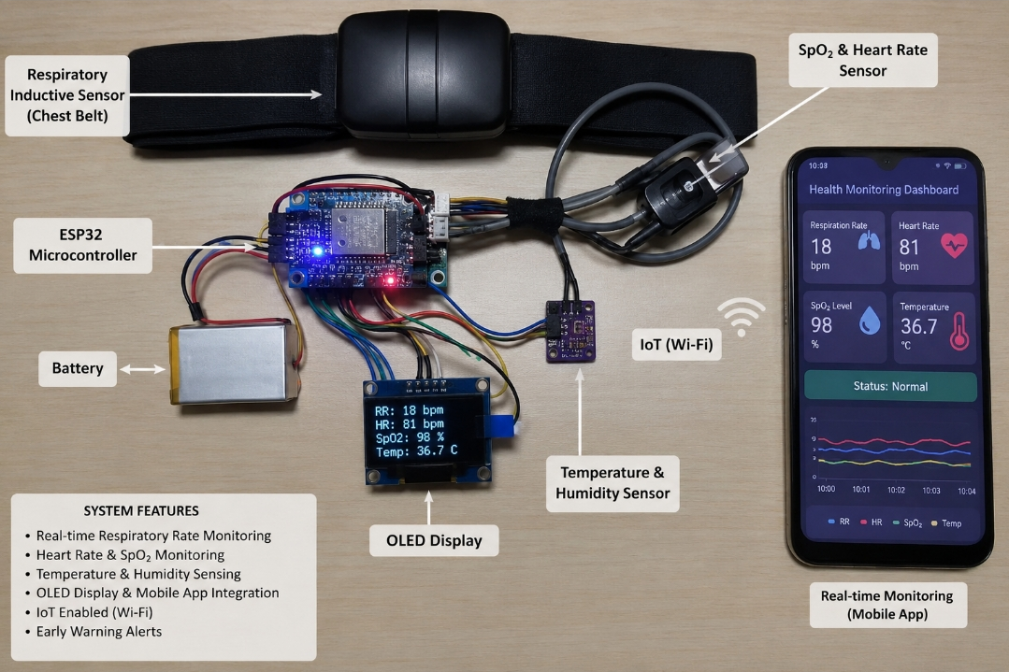
PROTOTYPE

Slide 16
CONCLUSION
The proposed wearable IoT system enables continuous, real-time monitoring of respiratory pattern together with SpO2, heart rate, and body temperature.
Fusing multiple physiological parameters improves the reliability of early-warning detection while reducing false alarms compared to single-parameter devices.
Instant local alerts and cloud/mobile-app notifications enable caregivers to respond quickly to apnea, bradypnea, tachypnea, or other abnormal readings.
The device’s compact, rechargeable, wearable design makes continuous multi-parameter monitoring feasible in homes, wards, and everyday settings.
Future enhancements such as AI-based anomaly prediction and long-term cloud analytics can further improve early diagnosis and patient outcomes.

Slide 17
REFERENCE
1. O. Y. Tham, M. A. Markom, A. H. A. Bakar, E. S. M. M. Tan and A. M. Markom, “IoT Health Monitoring Device of Oxygen Saturation (SpO2) and Heart Rate Level,” 2020 1st International Conference on Information Technology, Advanced Mechanical and Electrical Engineering (ICITAMEE), Yogyakarta, Indonesia, 2020, pp. 128-133.
2. Khushi Singh, Pradheep Thiyagarajan and Sasikumar P., “Design and Implementation of IoT Enabled Low Cost SPO2 and Heart Rate Monitoring System,” 2022 IEEE Delhi Section Conference (DELCON), 2022, pp. 1-6.
3. M. I. Kadhim, R. A. Fayadh and J. F. Mahdi, “Design a Medical Device to Monitor the Human Body (Blood Oxygen Saturation, Heart Rate, Body Temperature),” 2022 International Conference for Natural and Applied Sciences (ICNAS), 2022, pp. 52-57.
4. D. K. S. Nadiger, J. Dhanush, R. Vikas, S. K. B V, A. R. Naik and C. G. M, “E-Health Tracker: An IoT-Cloud Based Health Monitoring System,” 2022 4th International Conference on Smart Systems and Inventive Technology (ICSSIT), 2022, pp. 35-39.
5. Z. Jia, H. Huth, W. Q. Teoh, S. Xu, B. Wood and Z. T. H. Tse, “State of the Art Review of Wearable Devices for Respiratory Monitoring,” IEEE Access, vol. 13, pp. 18178-18190, 2025.

Slide 18
Thank You…!

